Slide 1
Ansible LAB

Slide 2
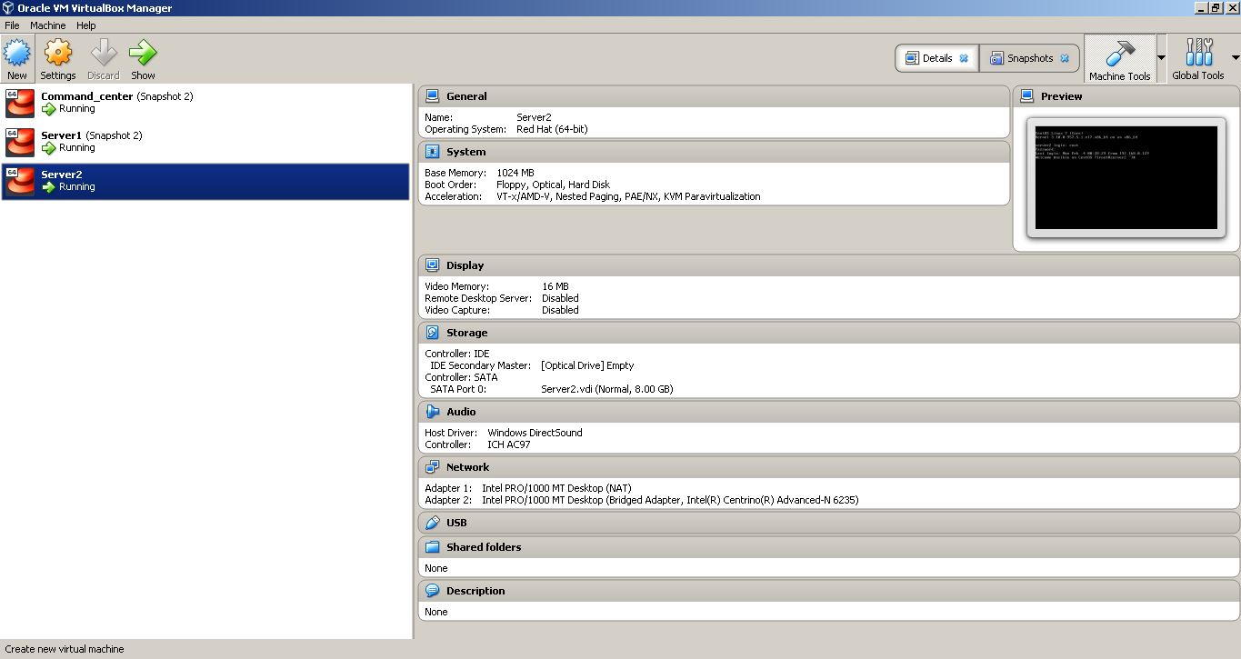
I created a network with three CentOS7 Virtual machines on VirtualBox, named Server1, Server2 and Commandcenter.

Slide 3
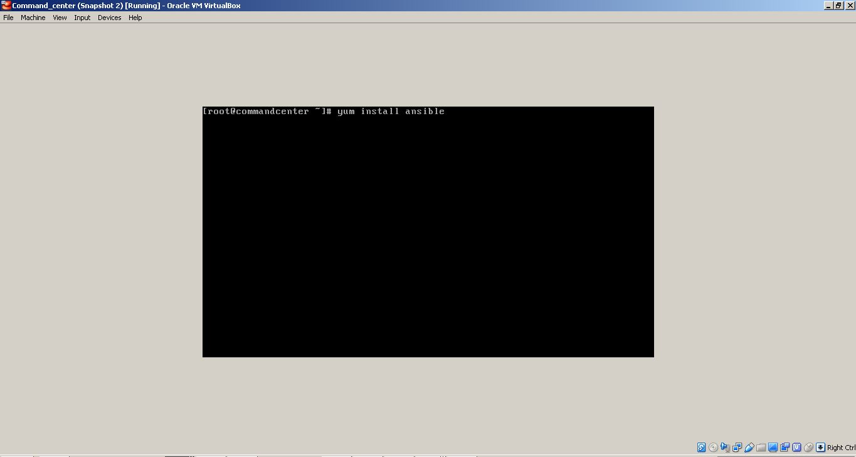
I installed Ansible on commandcenter machine, using the command: $yum install ansible

Slide 4
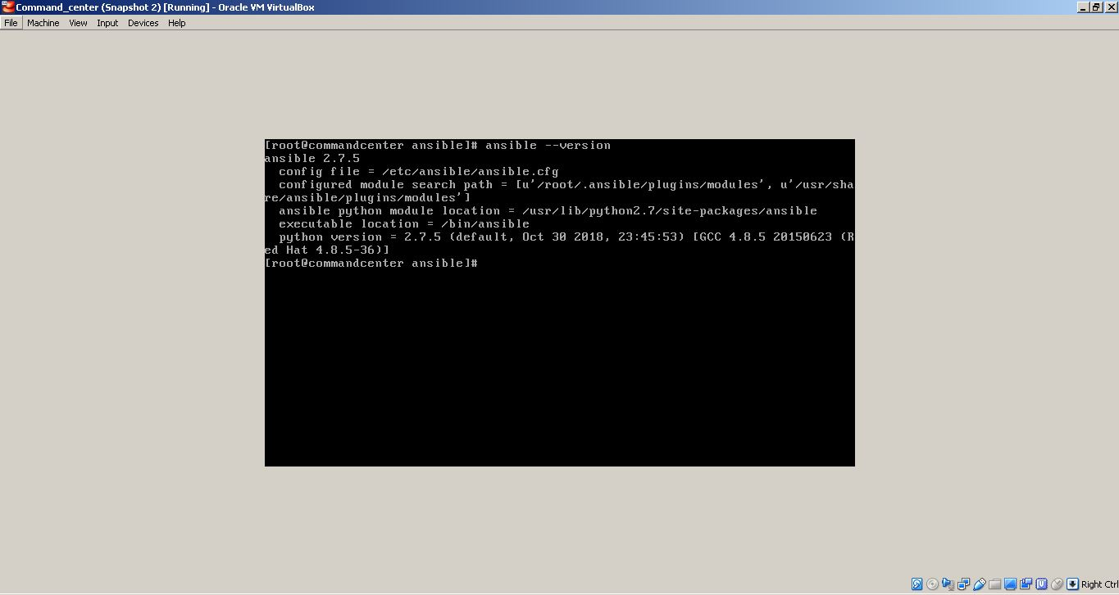
After the installation was finished I checked the version of Ansible

Slide 5
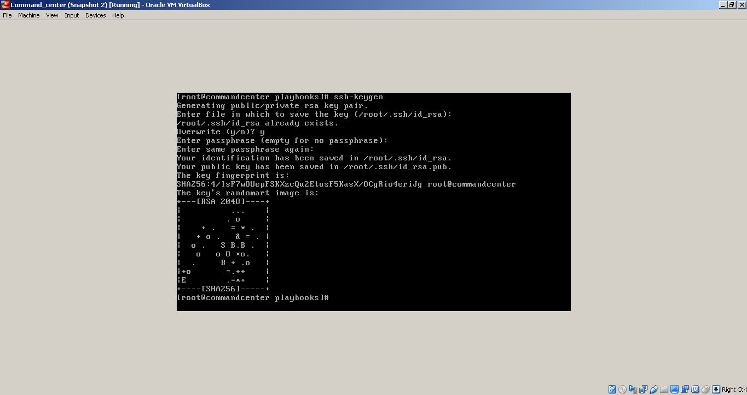
The next step is to generate a ssh rsa key on commandcenter machine, using the following command: $ssh-keygen

Slide 6
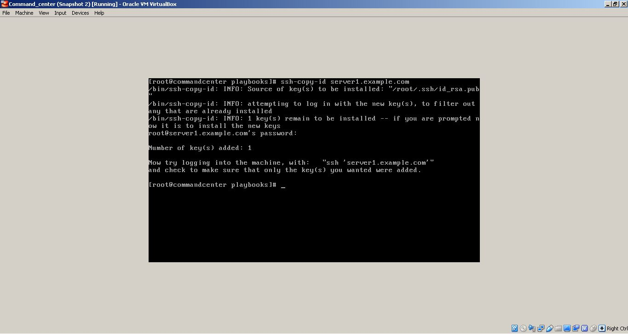
The generated ssh rsa key must be copied to the server1 machine, with the following command: $ssh-copy-id server1.example.com

Slide 7

The generated ssh rsa key must be copied to the server2 machine, with the following command: $ssh-copy-id server2.example.com

Slide 8
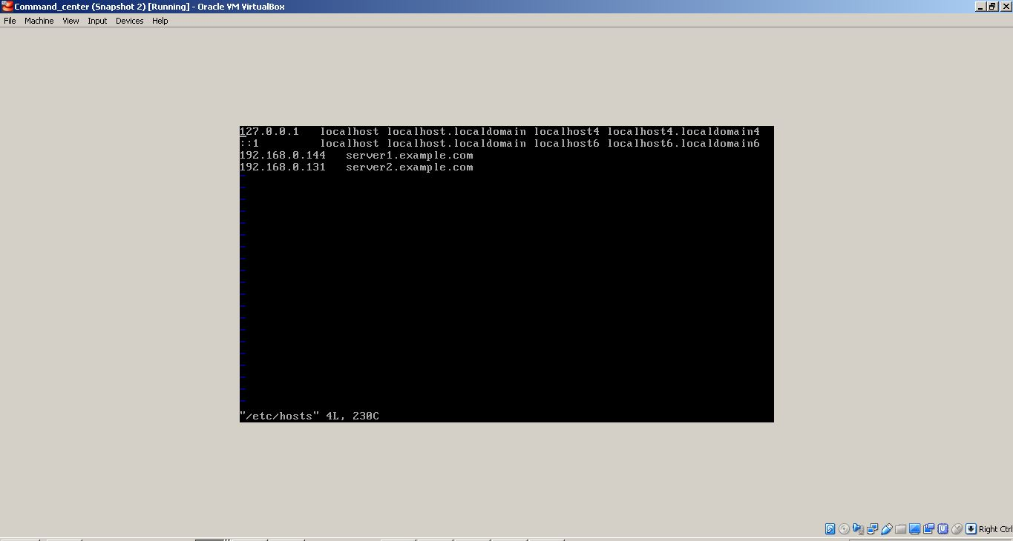
On commandcenter machine I added both machine in /etc/hosts (localhost name resolving)

Slide 9
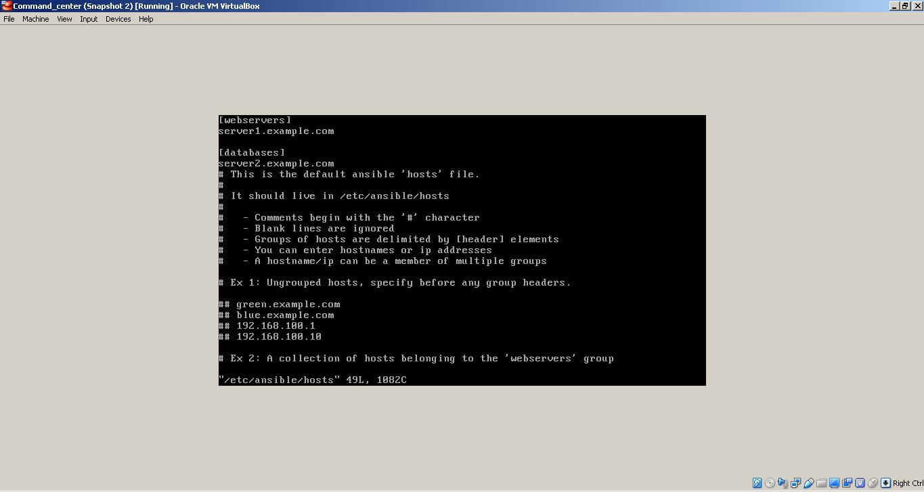
In /etc/ansible/hosts I created two groups: webservers (server1) and databases (server2)

Slide 10
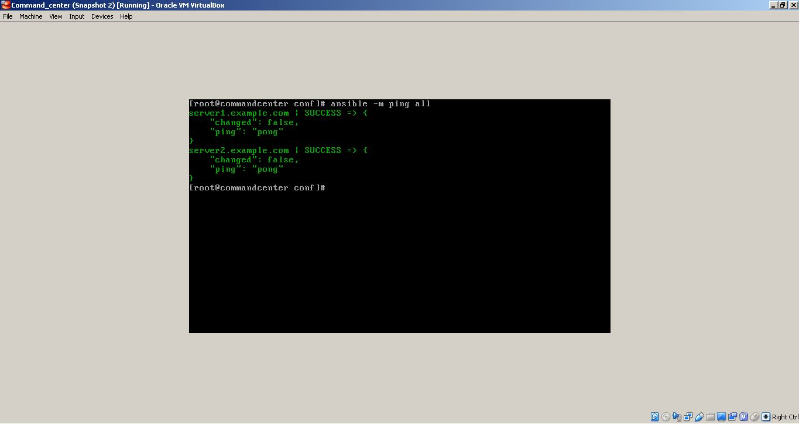
Checked the ansible connection between commandcenter machine and both hosts groups from /etc/ansible/hosts, with the following command: $ansible –m ping all

Slide 11
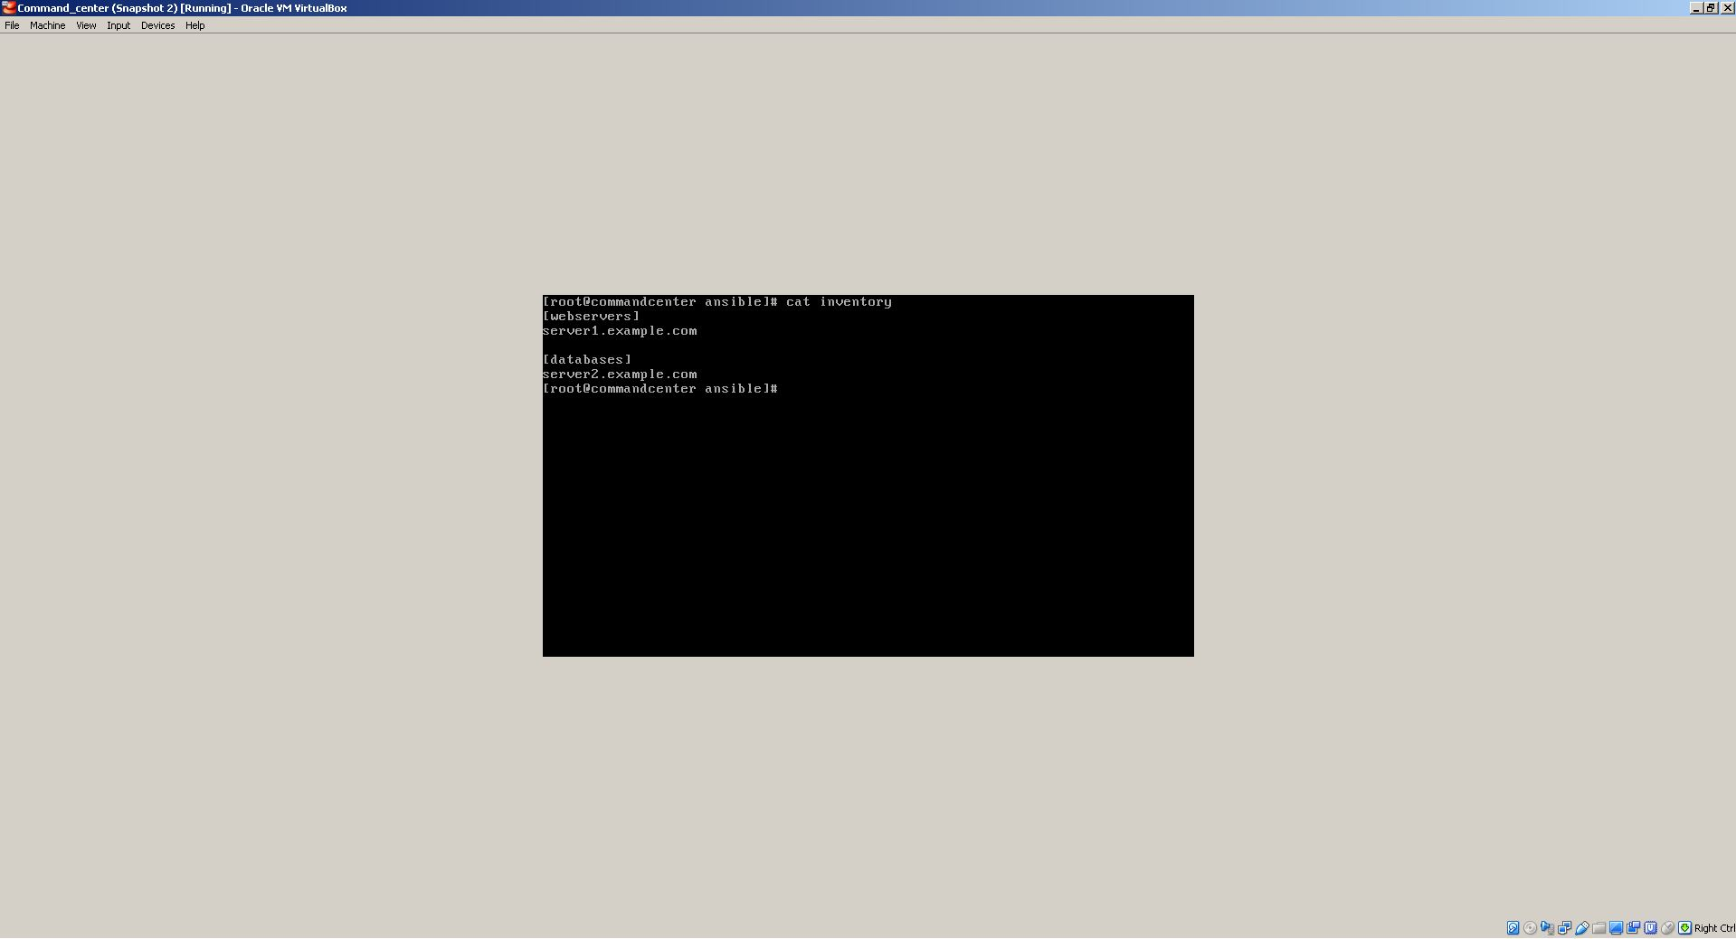
There is also another way to check the ansible connection between commandcenter machine and the host machines , to created in /etc/ansible/ a inventory file were you must enter the hosts groups

Slide 12
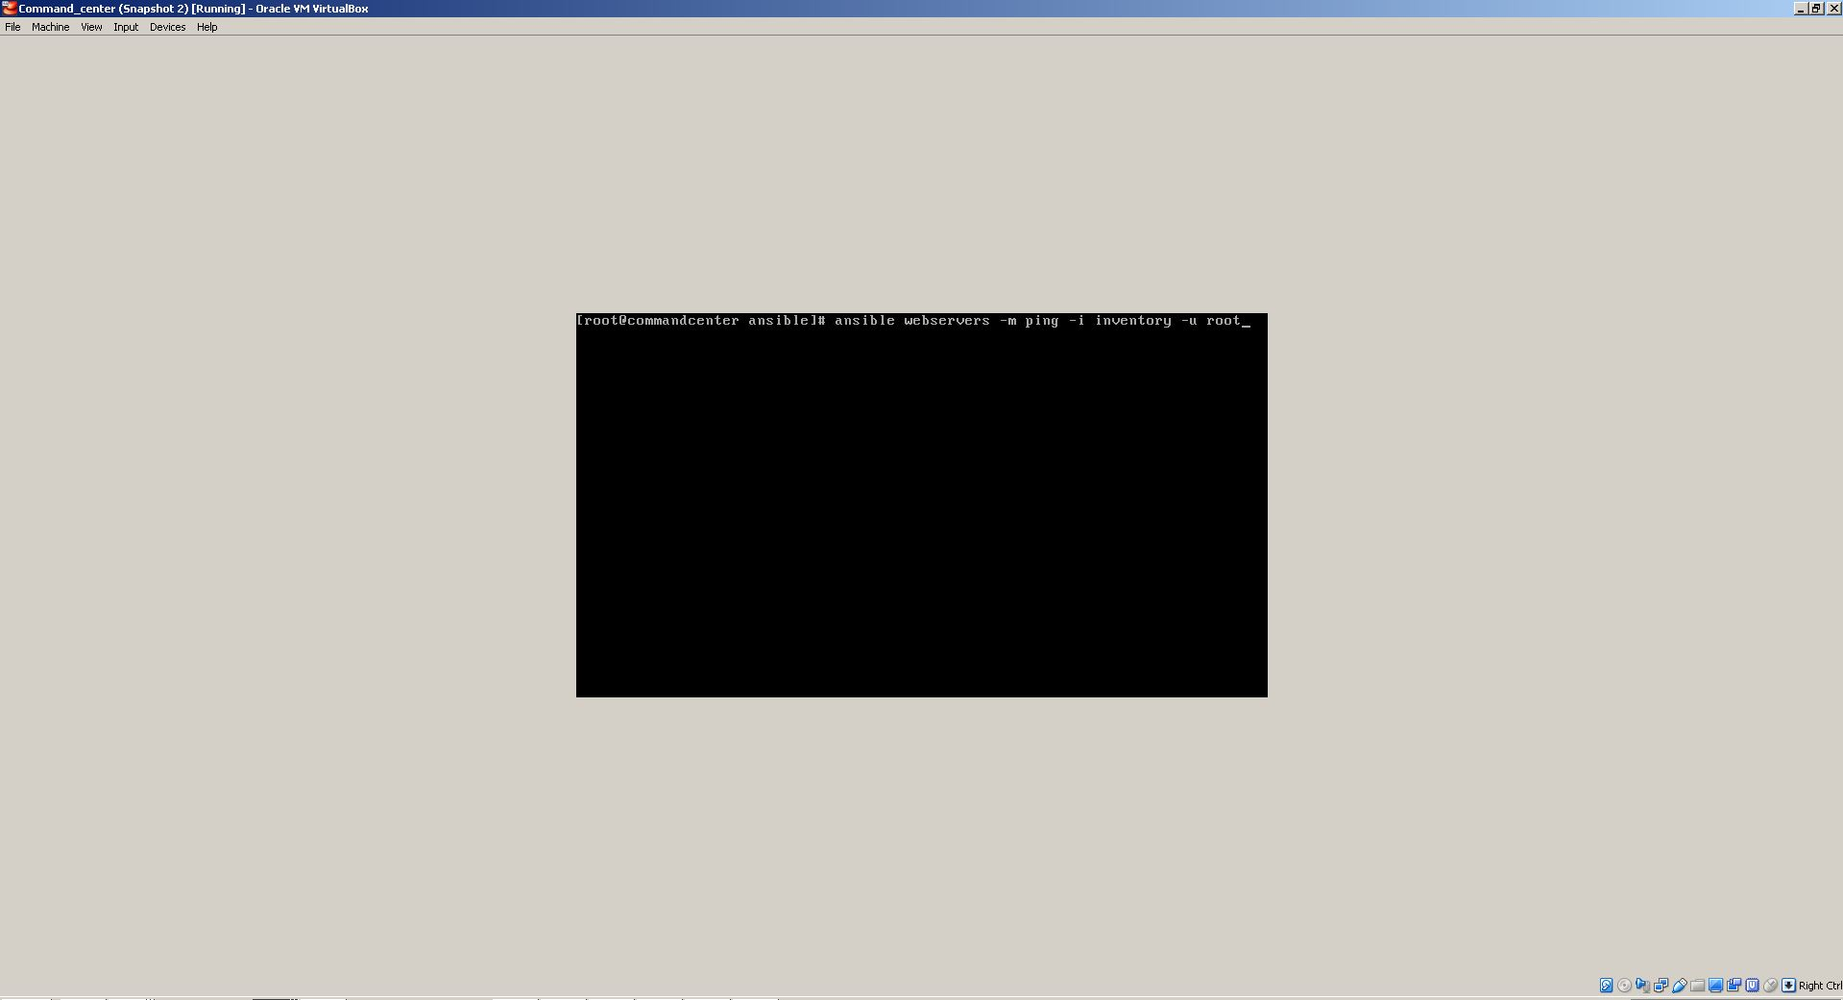
Check the ansible connection between commandcenter machine and ‘webservers‘ group from the inventory file, with the following command: $ansible webservers –m ping –i inventory –u root

Slide 13
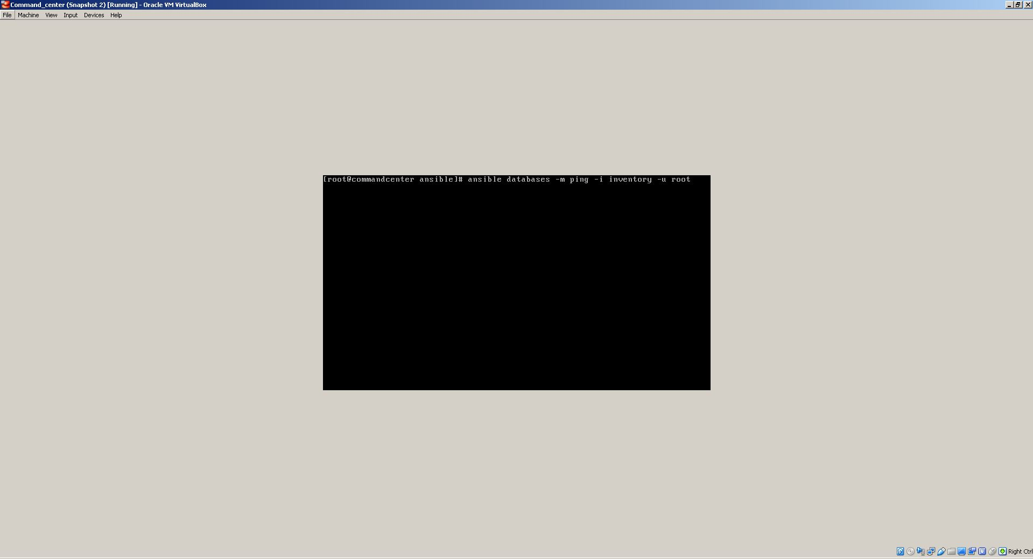
Check the ansible connection between commandcenter machine and ‘databases‘ group from the inventory file, with the following command: $ansible databases–m ping –i inventory –u root

Slide 14
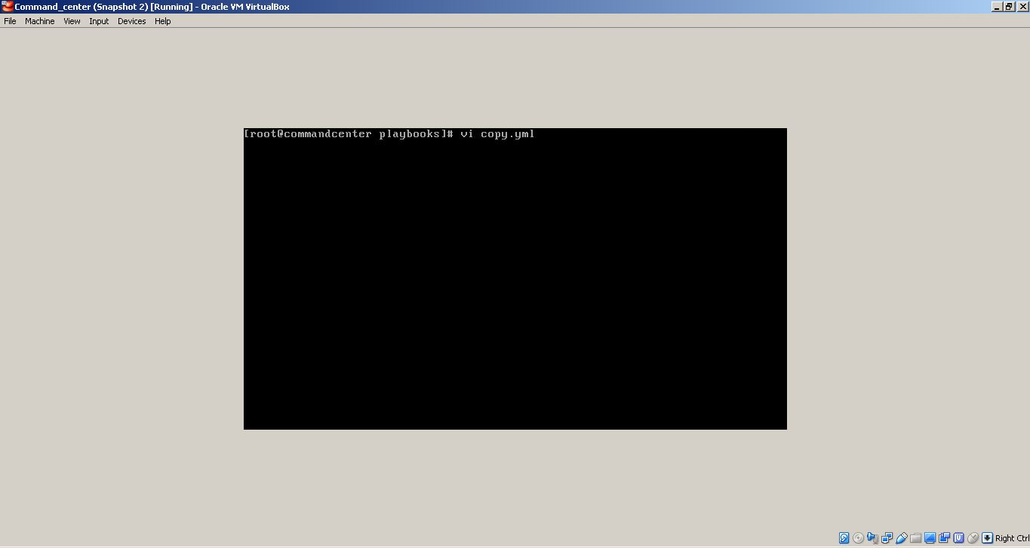
I made a folder /etc/ansible/playbooks where I created a playbook named copy.yml

Slide 15
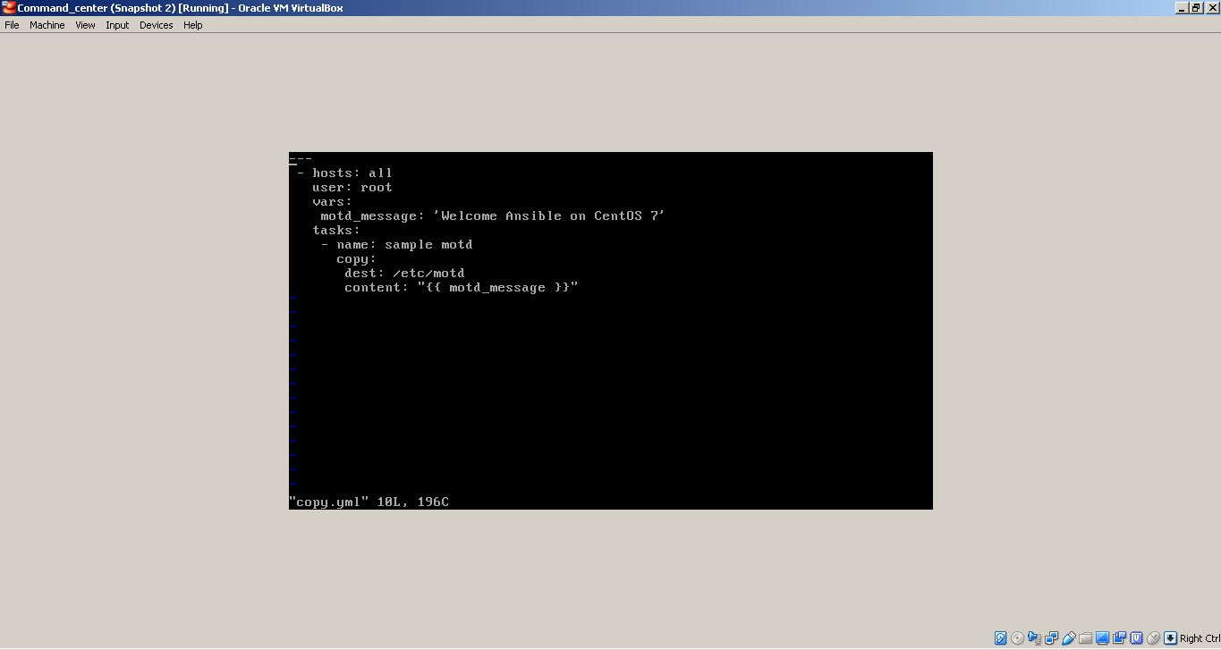
The copy.yml playbook will write the message of the day (motd): ‘Welcome Ansible on Centos 7’ to all machines that exists in /etc/ansible/hosts It creates a variable that contains the motd and copies it to /etc/motd on all machines:

Slide 16
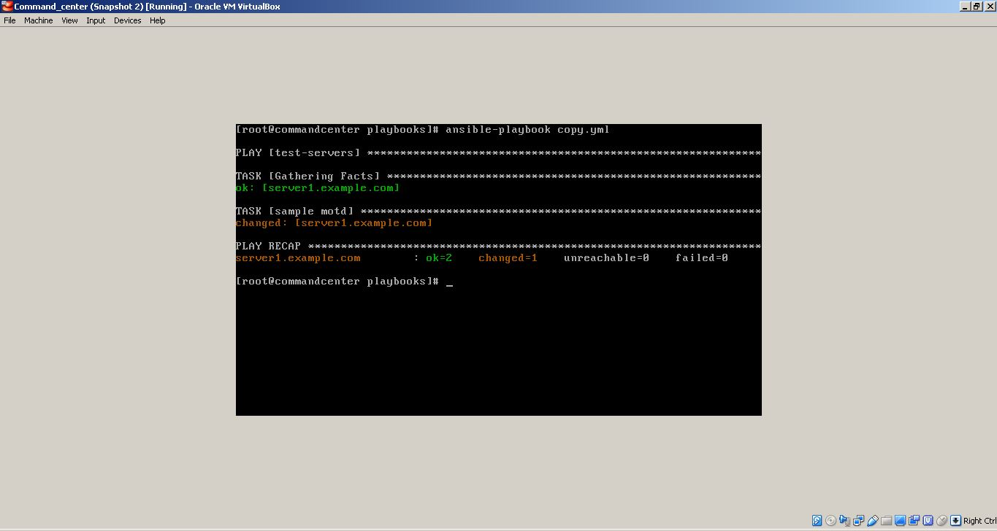
I executed with success copy.yml playbook using the following command: $ansible-playbook copy.yml

Slide 17
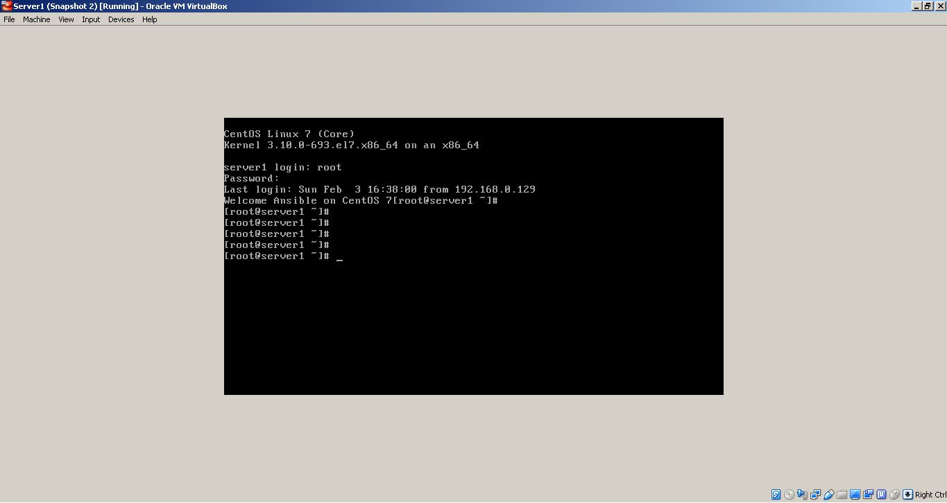
On server1 machine I check if the motd is displayed by logout/login

Slide 18
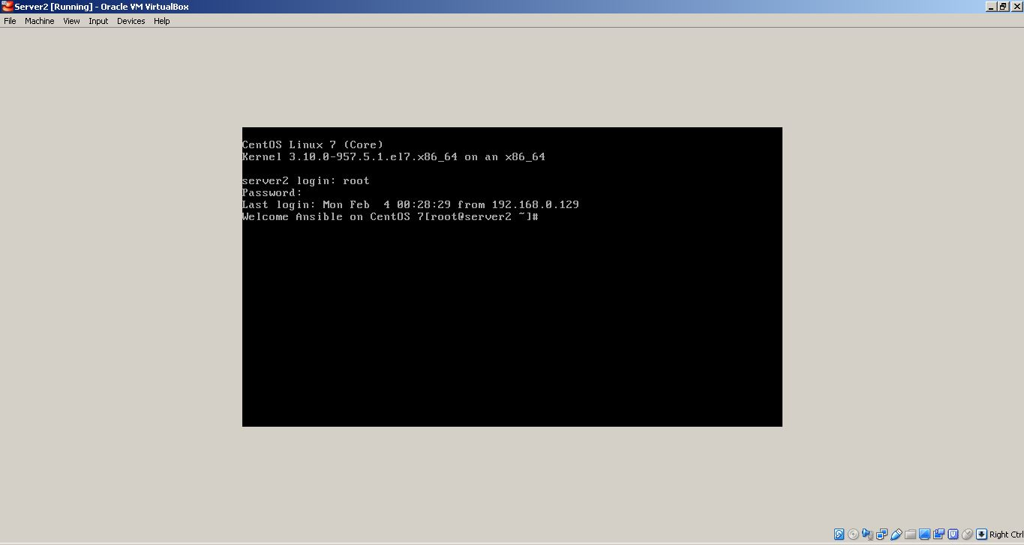
Checked also on server2 machine

Slide 19
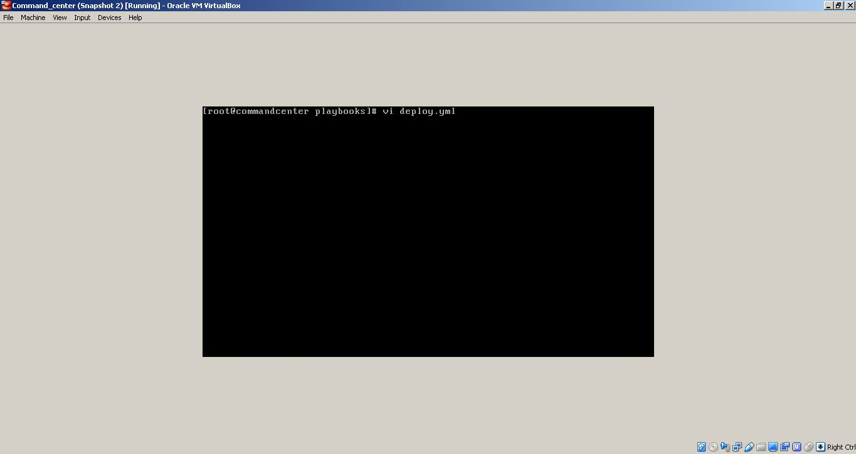
I created another playbook named deploy.yml

Slide 20
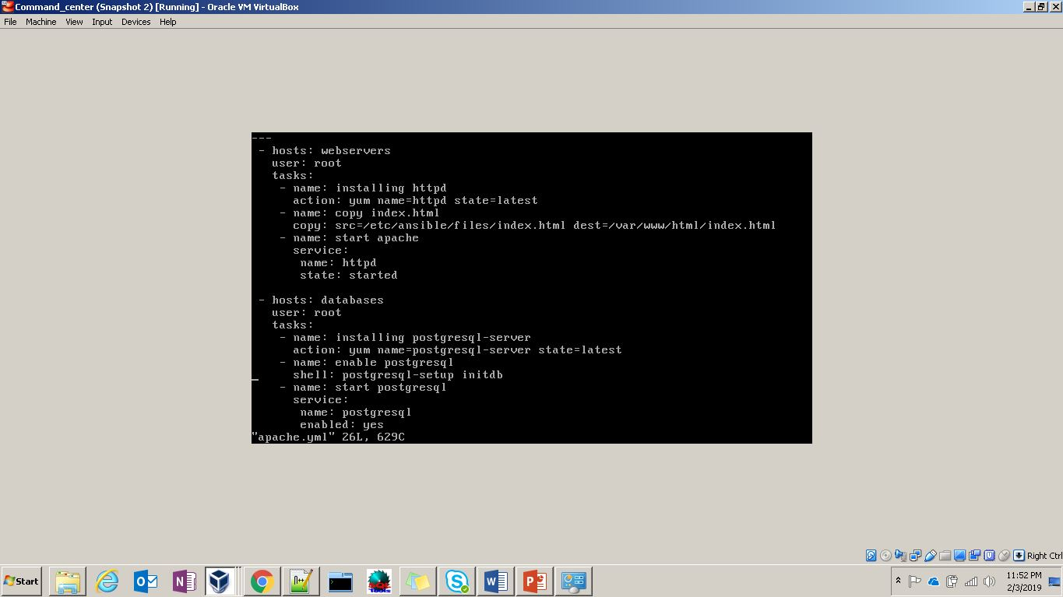
The deploy.yml playbook will install/enable on hosts group ‘webservers’ the Apache webserver, and copy the index.html file from commandcenter machine. On hosts group ‘databases’ will install/enable Postgresql.

Slide 21
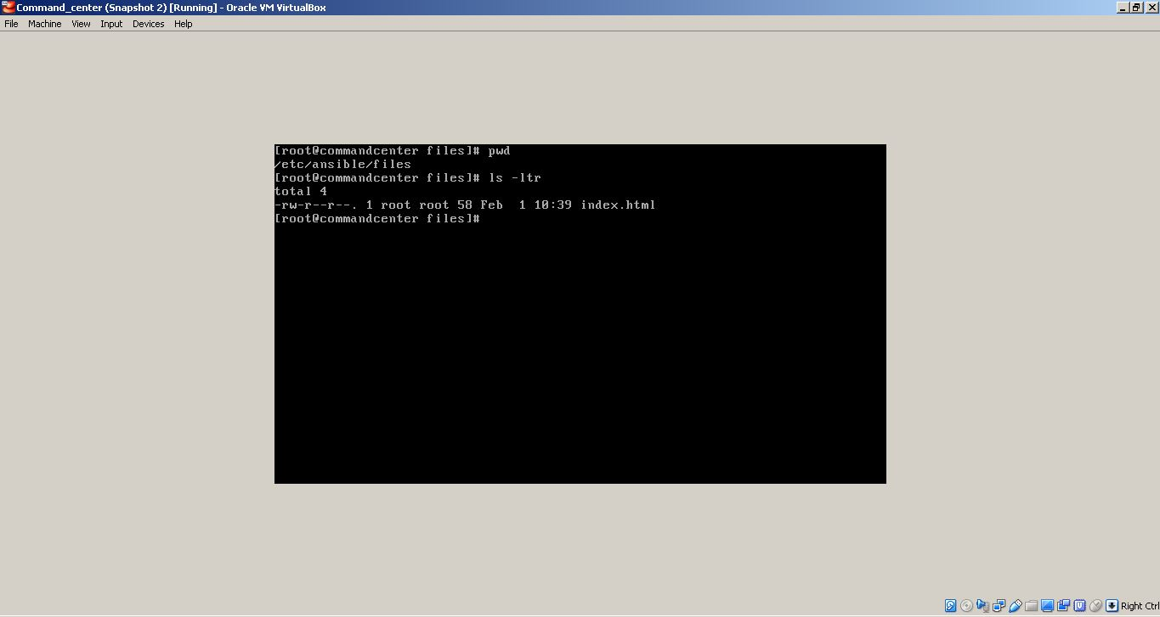
I made a folder /etc/ansible/files where I created a custom index.html file that will be copied in /etc/var/www/html/ on webservers hosts group

Slide 22
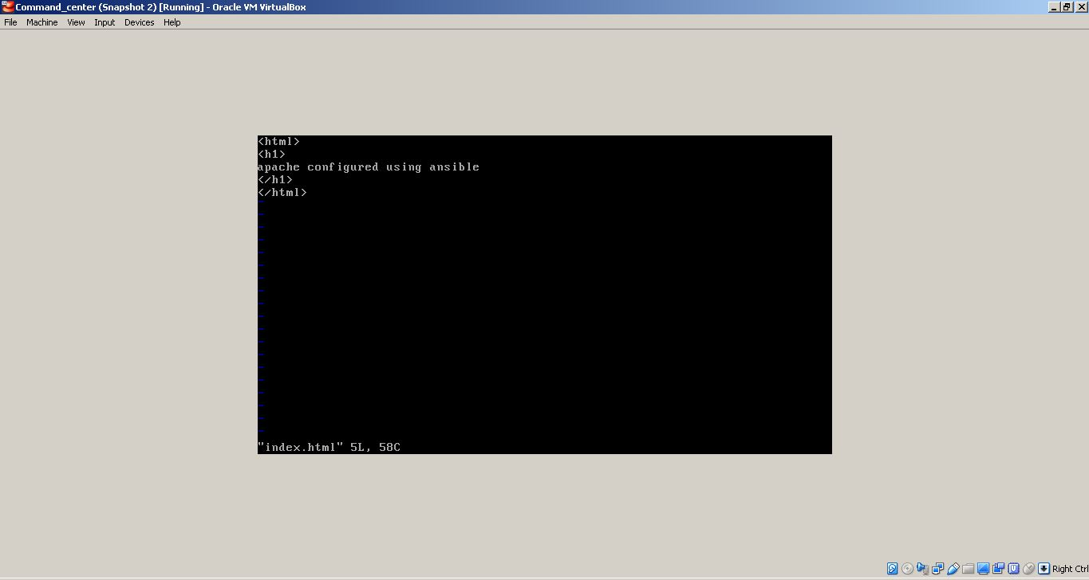
This the content of the index.html file created earlier

Slide 23
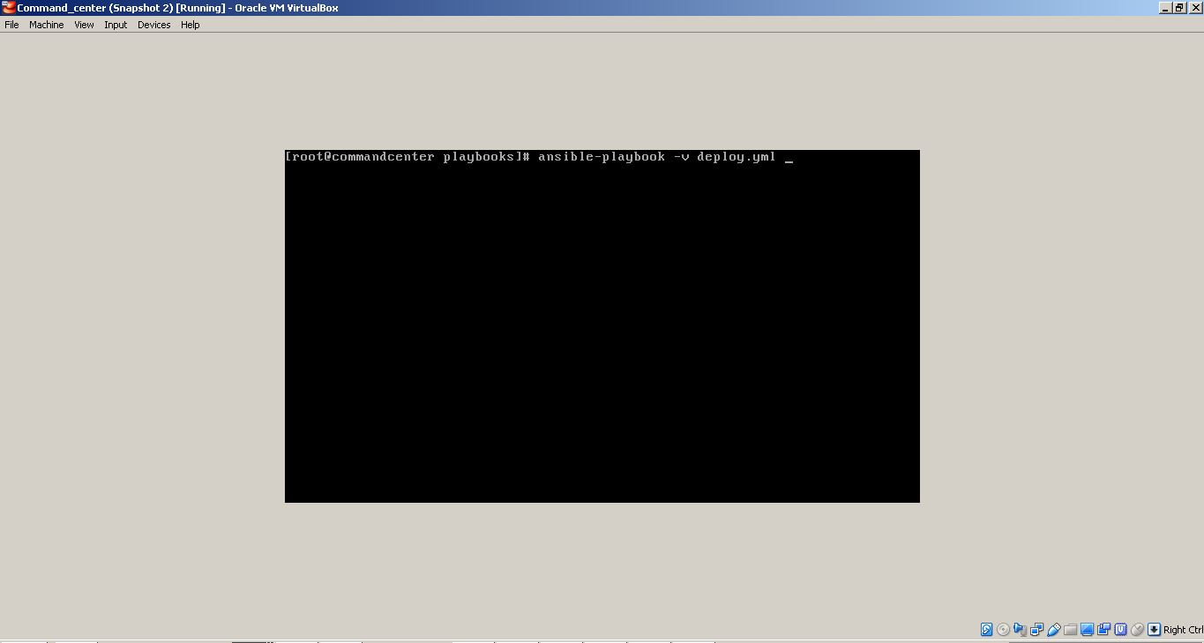
I executed deploy.yml playbook using the following command: $ansible-playbook -v deploy.yml -v = verbose

Slide 24
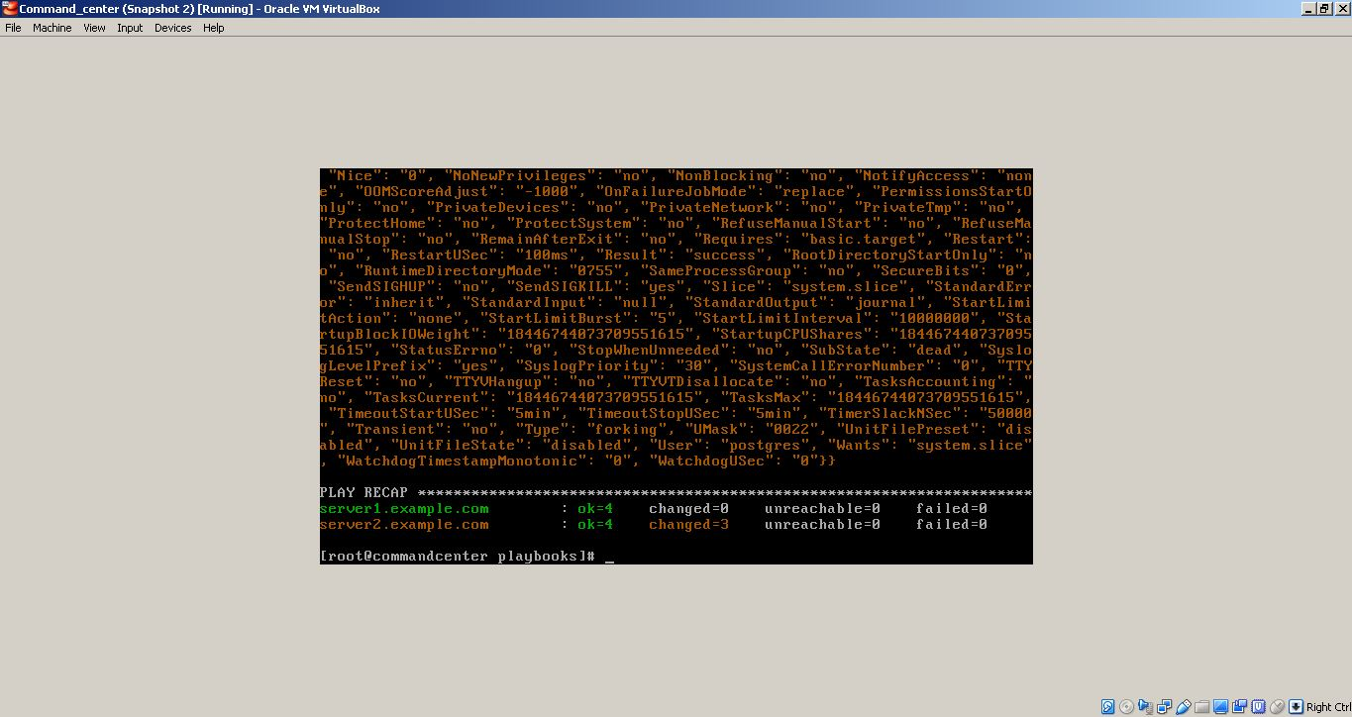
The deploy.yml playbook was executed with success for both hosts groups

Slide 25
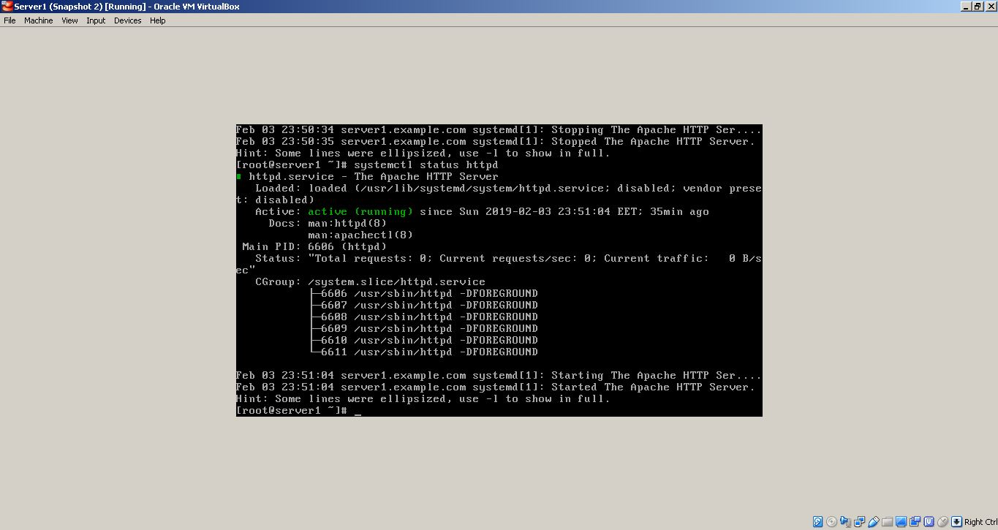
Checking on server1 if Apache is installed and running

Slide 26
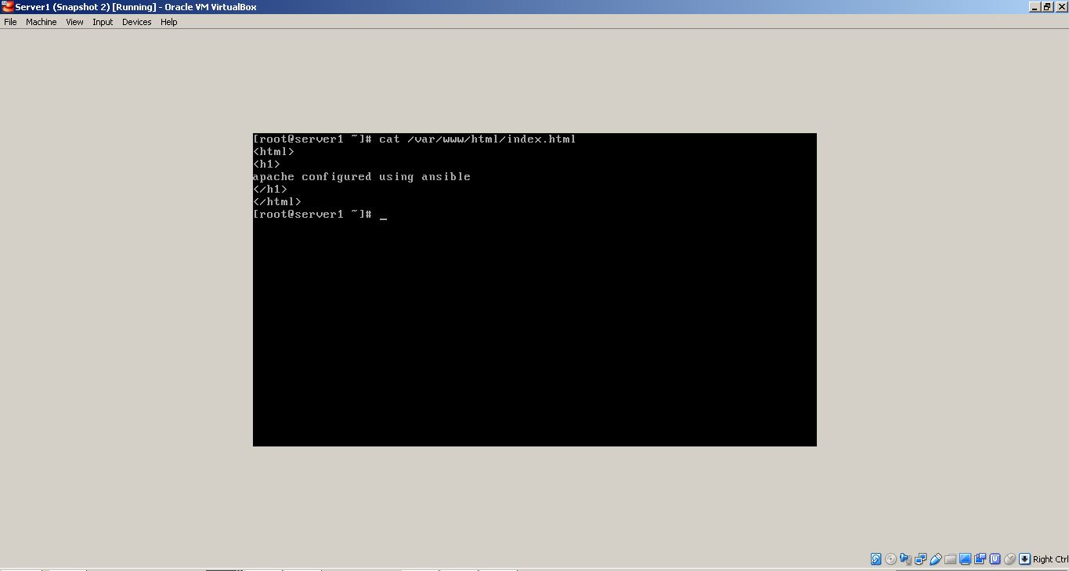
Checking on server1 if the custom index.files was copied in /etc/var/www/html/

Slide 27
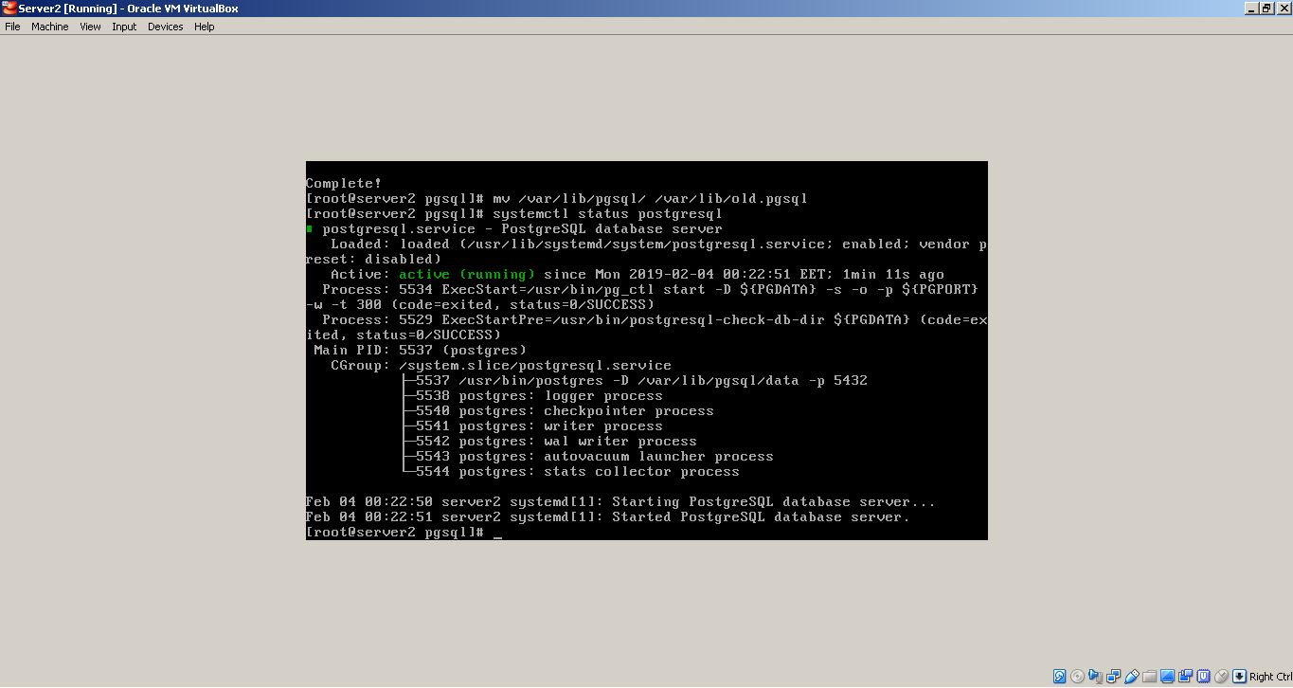
Checking on server2 if Postgresql is installed and running

